Slide 1
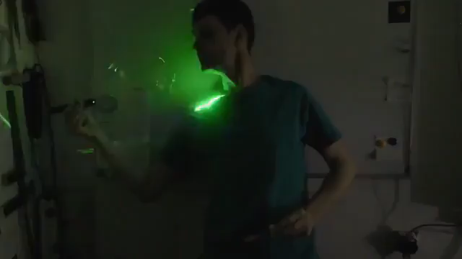
Exercise: Light force on a bubble
Exercise for week 5

